Slide 1
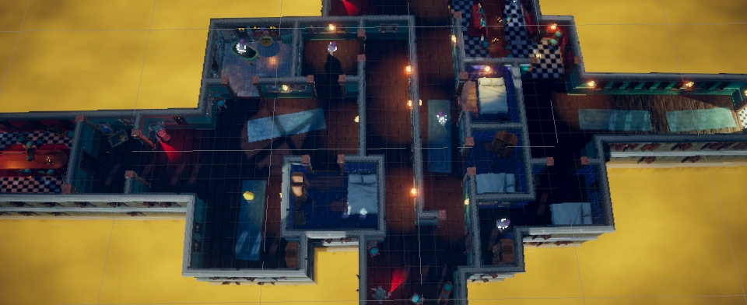
3D THE HAUNTED JAUNT ESCAPE ROOM GAME IN UNITY
BY SHRUTI KAMBALI

Slide 2
INTRODUCTION
PROBLEM STATEMENT
OBJECTIVES
The Enigmatic World of VR Escape Rooms
Learning Curve in VR Development
Scripting and Interaction Complexity
Scene Design for VR
Access to Resources
Immersive Scene Design
VR Animation and Interaction
Problem-Solving and Critical Thinking
VR User Interface (UI) Design
Narrative and Storytelling
Entertainment and Engagement

Slide 3
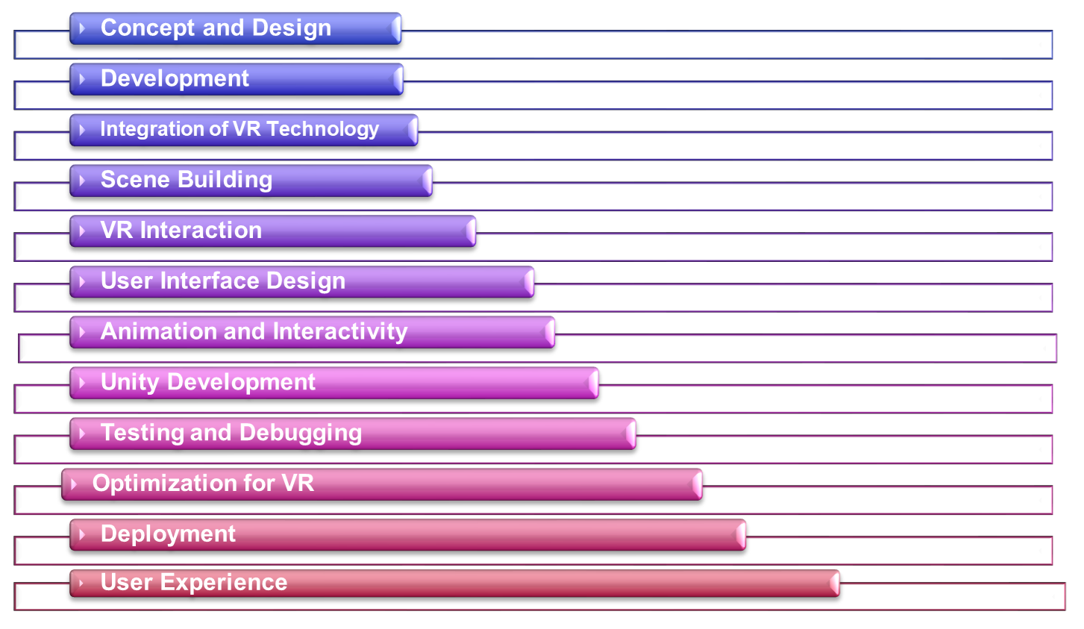
WORKING STAGES

Slide 4
Challenges deep-dive
Developing complex interaction scripts for VR controllers to enable players to interact with objects realistically.
Crafting a compelling and cohesive narrative that guides players through the escape room while maintaining educational objectives.
Addressing VR motion sickness challenges and ensuring player comfort during extended gameplay.
Complex Interaction Scripting
Asset Optimization
Narrative Design
User Interface in VR
VR Motion Sickness
Optimizing 3D assets and textures for performance without sacrificing visual quality
Designing user-friendly interfaces in a virtual reality environment, taking into account the unique challenges of VR interaction.

Slide 5
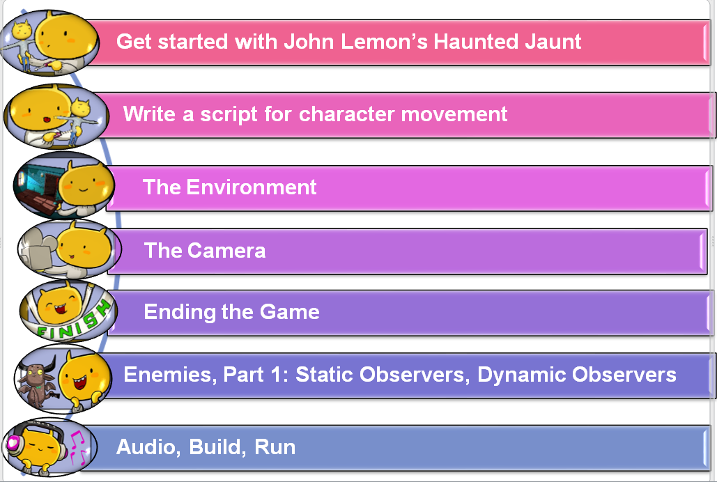
WORKFLOW

Slide 6
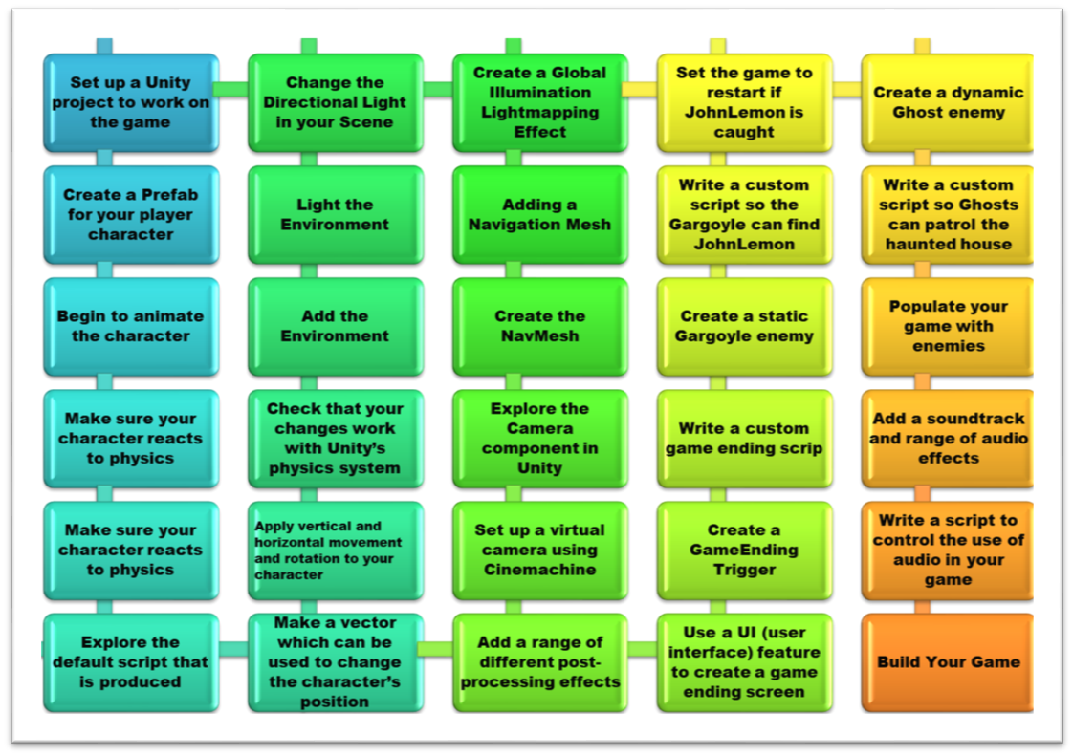
IMPLEMENTATION STEPS

Slide 7
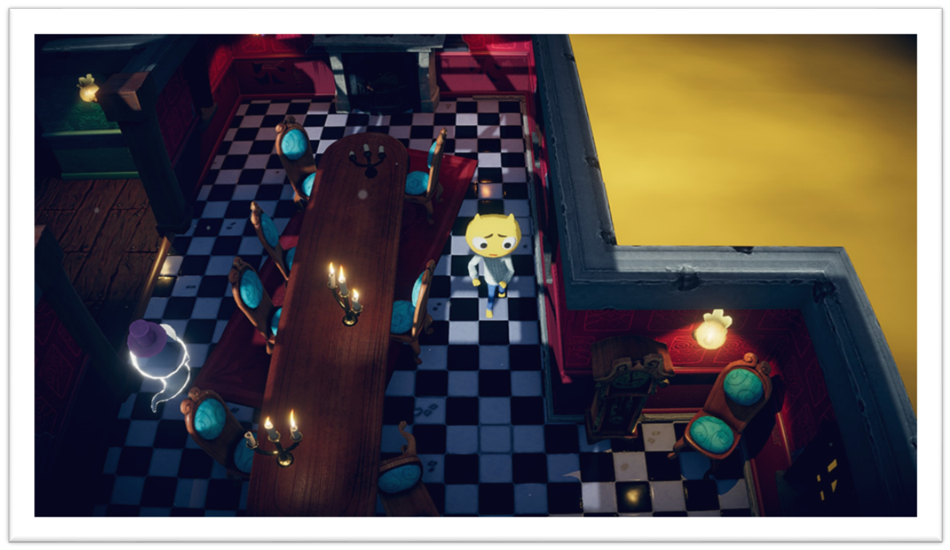
BEDROOM SCENE

Slide 8
DINING ROOM SCENE

Slide 9
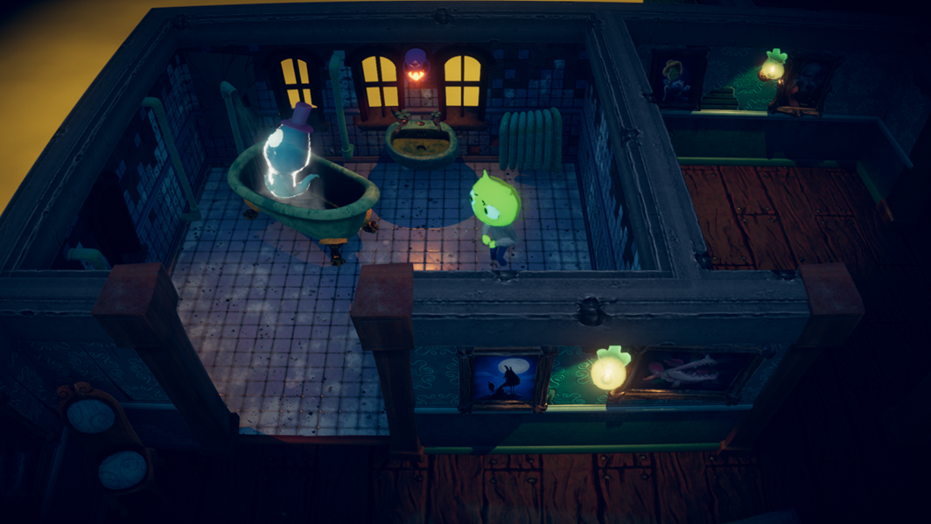
BATHROOM SCENE

Slide 10
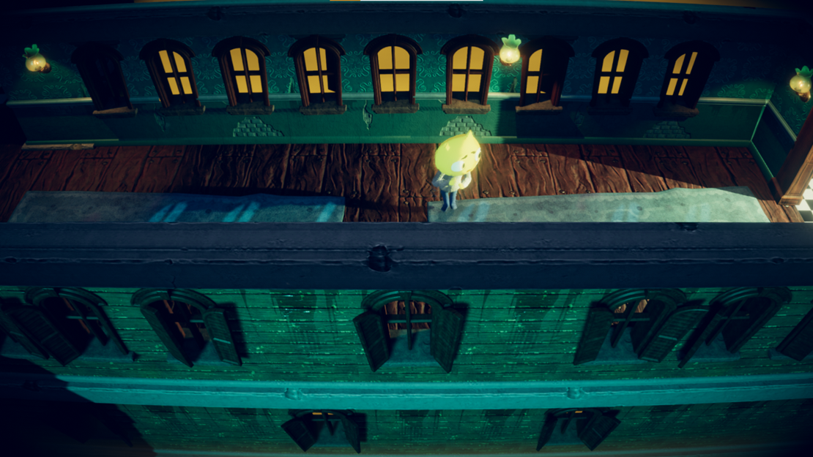
Corridor Scene End State

Slide 11
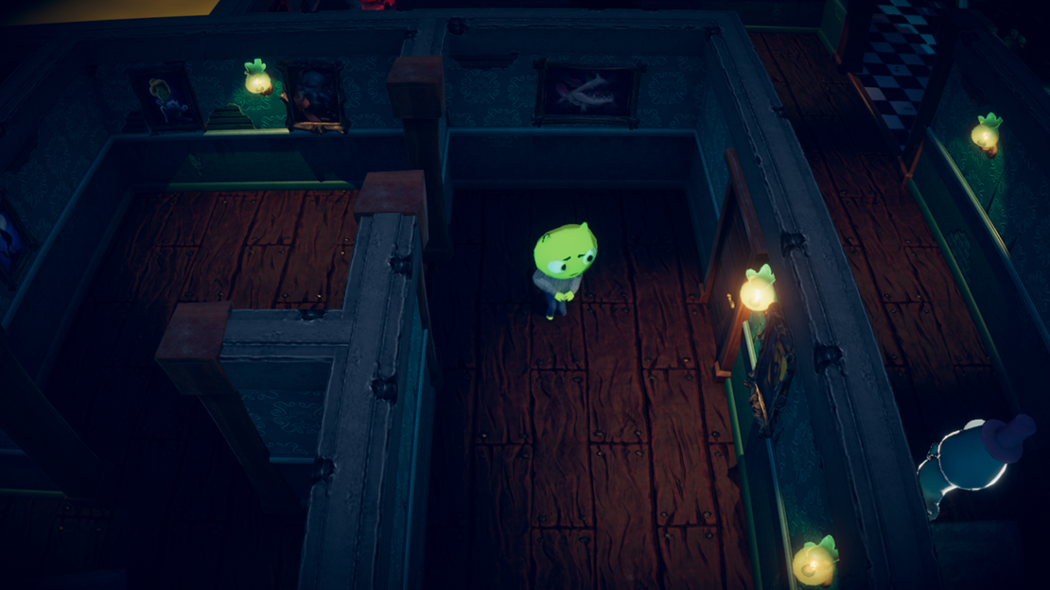
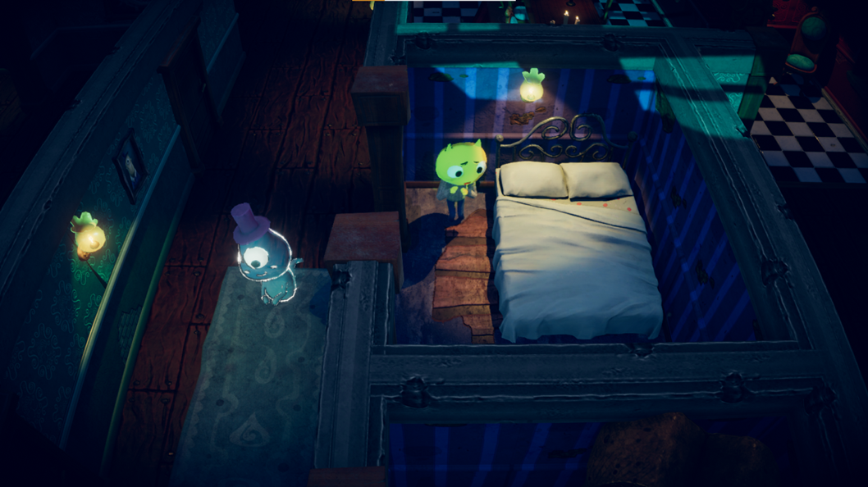
EXTERIOR WALL SCENE

Slide 12
CONCLUSION
In conclusion, the development of the 'Haunted Jaunt Escape Room Game' in Unity has been a testament to the fusion of technology, creativity, and education. It's a project that bridges the gap between traditional learning methods and the captivating world of virtual reality."
"We've successfully created an experience that engages learners, challenges their critical thinking, and immerses them in an exciting adventure. This achievement is a testament to the innovative potential of VR in education."
"Throughout our journey, we've embraced the challenges and overcome obstacles, strengthening our problem-solving skills and understanding of VR development. The project showcases the power of determination and creative thinking."
"As we look ahead, the 'Haunted Jaunt Escape Room Game' serves as a stepping stone into the exciting future of virtual reality. The possibilities are boundless, and we're excited to continue exploring the intersection of education and entertainment in this dynamic landscape."
"Thank you for joining us on this VR adventure. We hope that our project inspires you to embark on your own journeys in the world of virtual reality and that you, too, find endless opportunities for creativity and learning."

Slide 13






FUTURE SCOPE
Enhanced Puzzles and Interactions
Develop more intricate and challenging puzzles that require advanced problem-solving and critical thinking skills.
Content Creation Tools
Develop user-friendly tools for players and educators to create and share their escape room scenarios, fostering a collaborative community of creators.
Incorporation of Emerging Technologies
Explore the integration of emerging technologies, such as augmented reality (AR) and advanced haptic feedback, to enhance the immersive experience.

